Slide 1

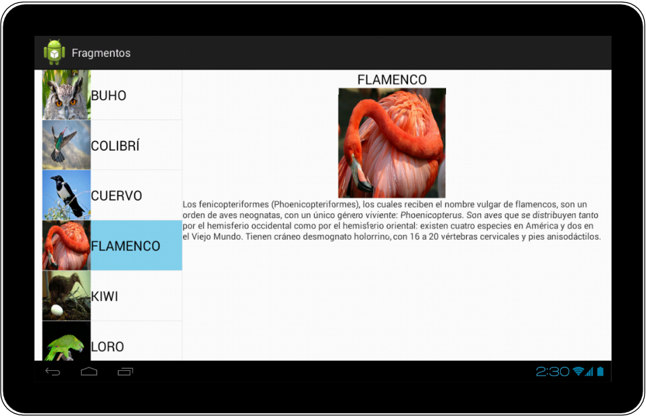
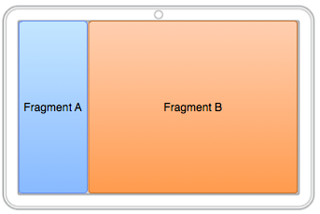
Android Fragments
Dimitar Ivanov
Mobile Applications with Android
Telerik Software Academy
http://academy.telerik.com

Slide 2
About Fragments
New in Android 3.0 (Honeycomb, API 11)
Usable in previous versions with compatibility library
Intended to reuse layouts between tablets and phones
But usable for many more...
Definition:
A Fragment represents a behavior or a portion of user interface in an Activity.

Slide 3
Interaction with Activities
A fragment is a modular section of an activity, which has its own lifecycle...
But, a fragment's lifecycle is directly affected by the host activity's lifecycle
Activity paused: fragments paused
Activity destroyed: fragments destroyed
Activity running: fragments can have different states

Slide 4
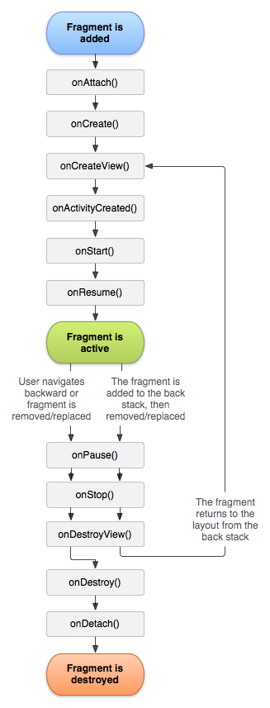
Fragment Lifecycle
onCreate()
The system calls this when creating the fragment.
onCreateView()
The system calls this when it's time for the fragment to draw its user interface for the first time.
onPause()
The system calls this method as the first indication that the user is leaving the fragment (though it does not always mean the fragment is being destroyed).

Slide 5
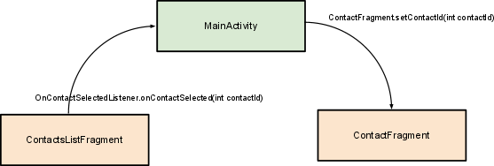
Communication Between Fragments

Slide 6
Android Fragments
http://academy.telerik.com

Slide 7
Homework
Create an activity with two fragments
One shows a list of products
Only their name and category
Each product can be tapped
If a product is tapped, the other fragment appears, showing the details for the product: name, id, category, quantity and price

